Slide 1

Slide 1
Volatility of Industrial Growth towards various economic factors
A Technical Analysis

Slide 2
Introduction
Growth of an Industry is of utmost importance. History of economic development shows close relation between industrial growth and level of per capita income of a country.
Industry sector important for increase in GDP of a nation which is responsible for growth of nation.
Slow growth of industrial sector is responsible for poverty and mass-unemployment.

Slide 3
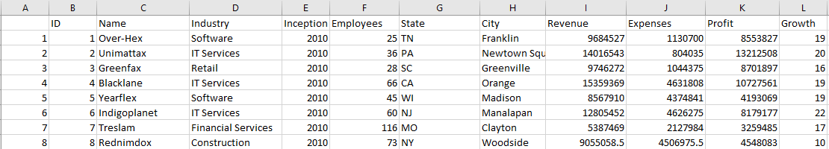
Background of Data set
Dataset Description :
U.S company based dataset.
Comprises of 500 different companies.
It consists of 11 attributes and 500 rows.
Publicly available and can be used by anyone for research purpose.
https://www.superdatascience.com/pages/rcour se-advanced.

Slide 4

Business Question.
How much variability does the dependent variable (Growth) show on Independent variables (industry sector, employee, profit, revenue and expense)?
Which economic factor uniquely explains variability to the Growth of a company?
Which company sector should be preferred by an investor or business owner for extension of business?
H0: There exists no correlation between Growth of company and Industry Sector.
H1 :There exists correlation between Growth of company and Industry Sector.

Slide 5

Methodology
Visual Data Analytics
R
Multiple Regression
Multiple Linear Regression
Tableau

Slide 6
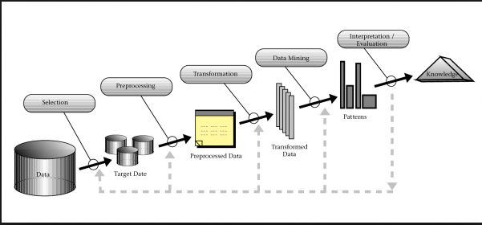
Proposed Methodology
KDD methodology has been followed
Key Steps to implementation
Data PreProcessing
Identifying the dependent and independent variable
Exploratory Data analysis
Building the Model
Analysing Results

Slide 7
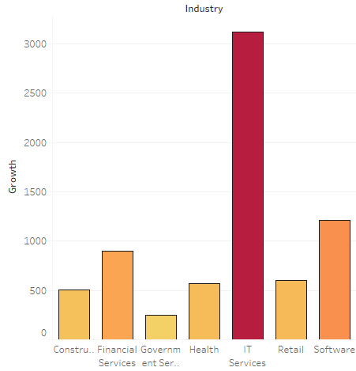
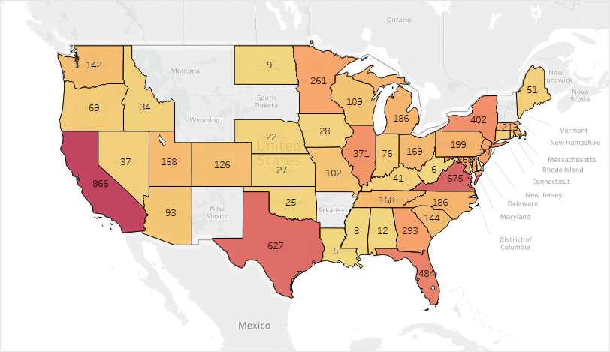
Implementation
1. Visual Data Analytics : Tableau
Bar Chart – Growth by Industry
Map – Showing Growth rate in U.S

Slide 8
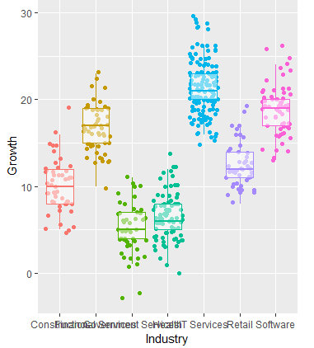
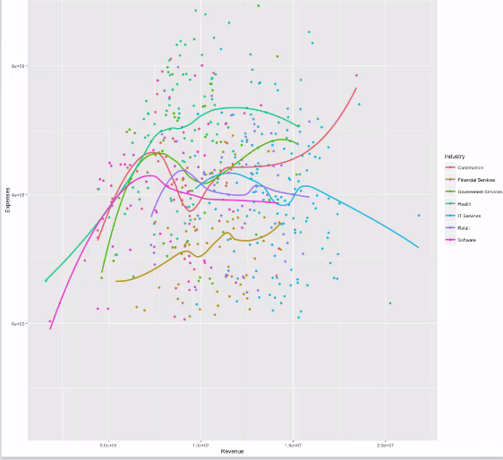
Implementation
2. Visual Data Analytics : R
Box-Plot showing Growth by industry
Trend analysis of Revenue and Expenses

Slide 9
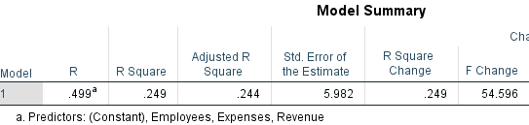
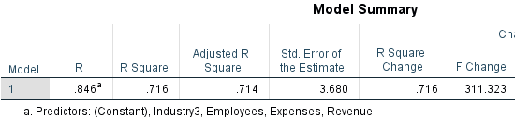
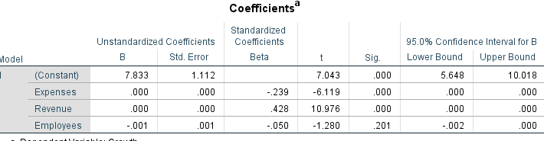
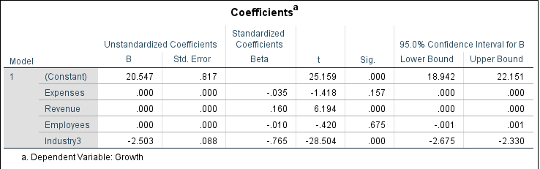
Implementation
3. Multiple Linear Regression : IBM SPSS
Test without Industry variable
Test with Industry variable

Slide 10
Conclusion
Alternate hypothesis was proved to be statistically significant . There existed relationship between Growth and Industry Sector.
California with the highest growth rate.
I.T sectors to be producing the highest growth rate.
Industry sector proven to be uniquely and strongly explaining growth at .765 beta value.
Independent variable explained 71.6 percent variability in dependent variable.

Slide 11




Thank You
ATIF FEROZ JEELANI
X17169992
Msc Data Analytics
National College of Ireland

